Slide 1



Un paseo de Ruby hasta ruby on Rails
Roberto Amadeo Hernandez Capistran

Slide 2
Ruby
Object-oriented programming languages
Created in 1995 by Yukihiro Matsumoto(“Matz”)
Used for many purposes, not only web applications
Easily readable

Slide 3
Using Ruby
Single command
Interactive Ruby Shell
Ruby File

Slide 4
Single Command
Ruby –v
ruby -e 'puts 123’

Slide 5
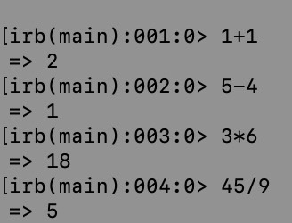
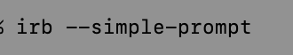
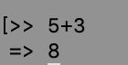
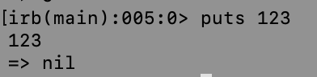
Interactive Ruby Shell (IRB)

Slide 6
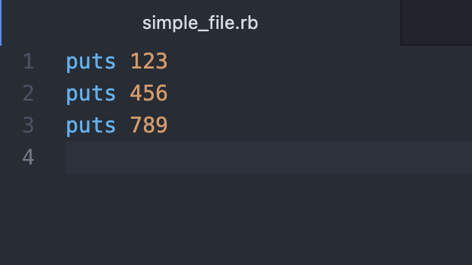
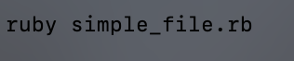
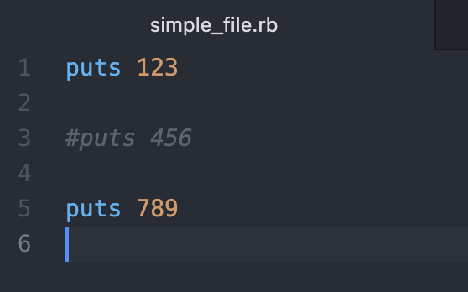
Ruby File

Slide 7
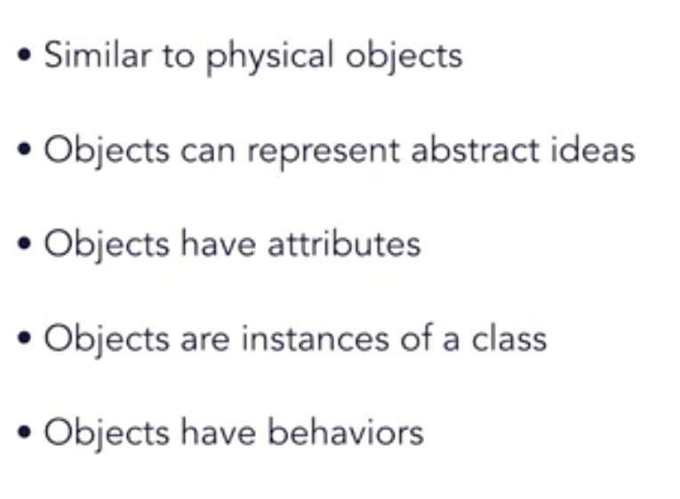
Object

Slide 8
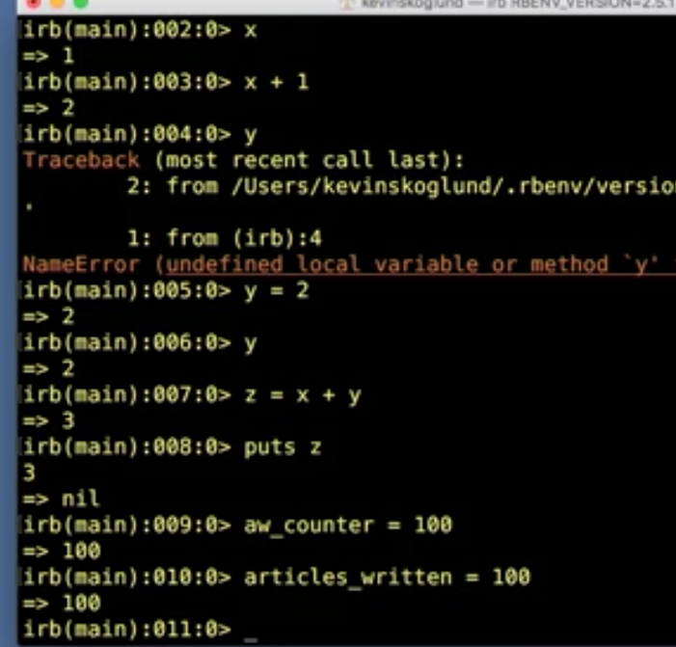
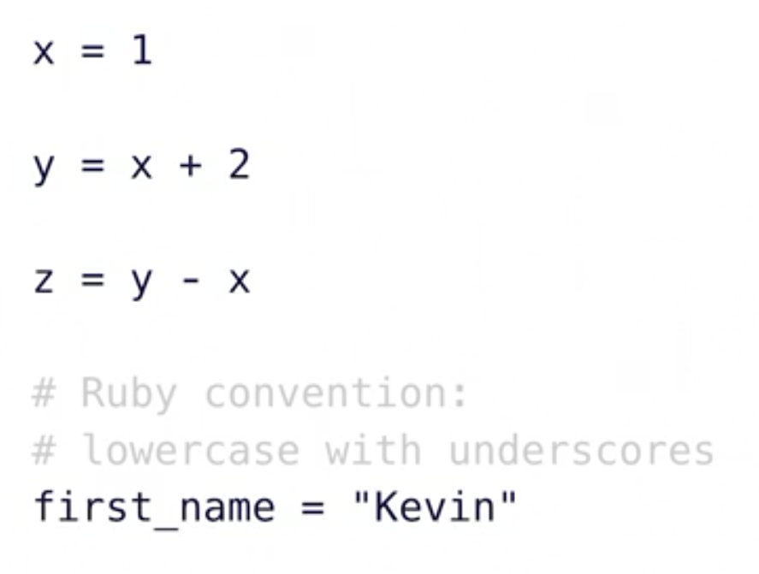
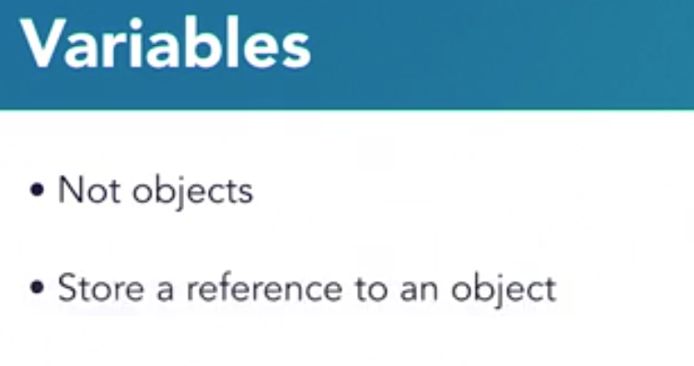
Variable

Slide 9
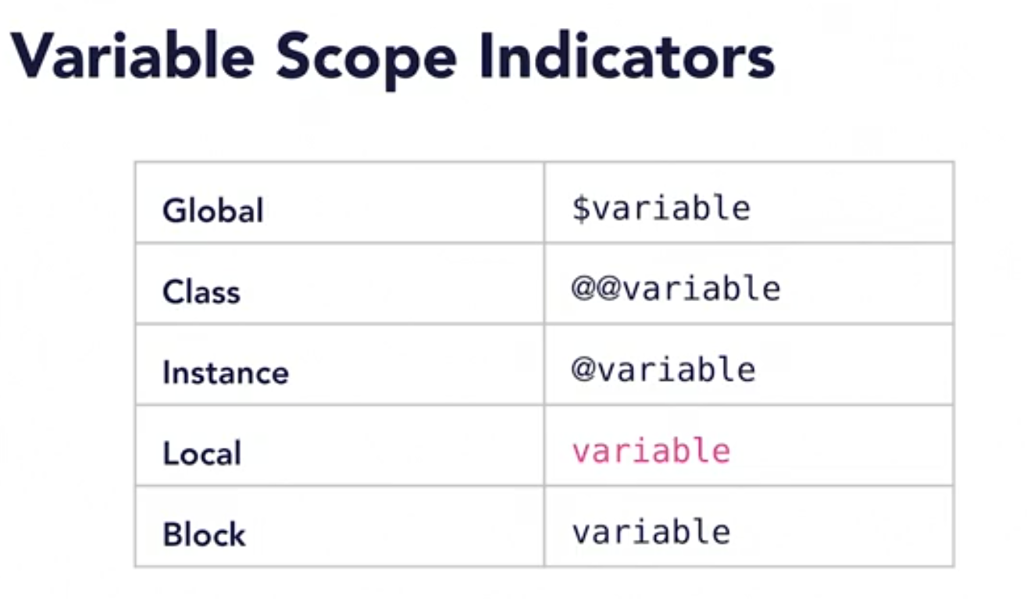

Slide 10
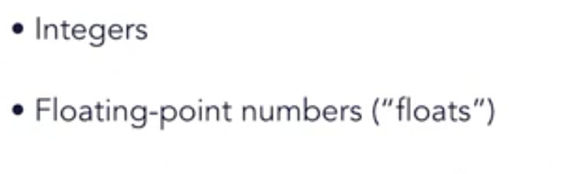
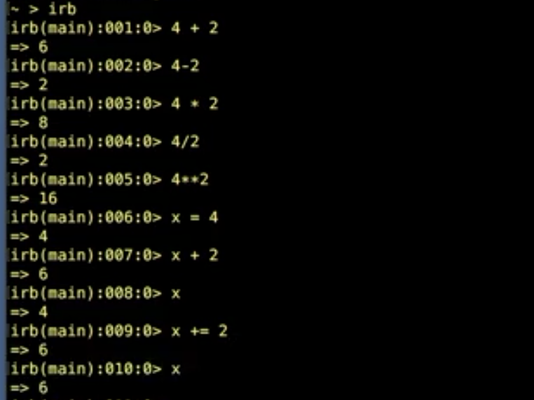
Numbers
4**2
X+=2
123.class

Slide 11
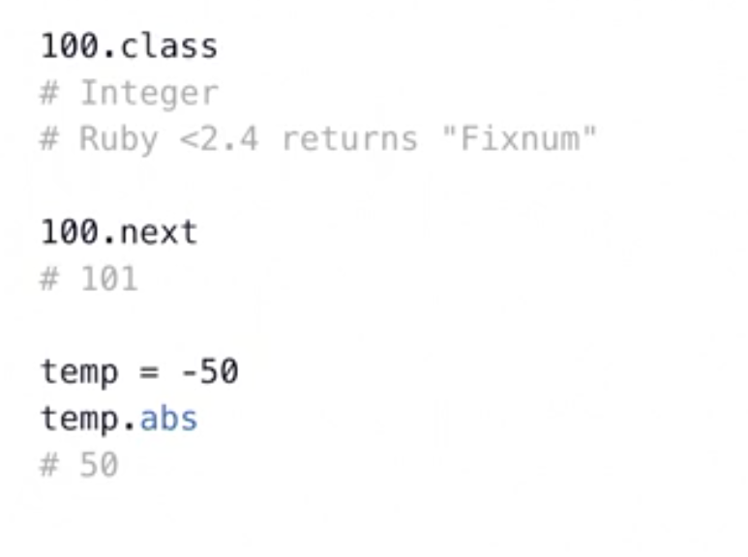
Integer Methods

Slide 12
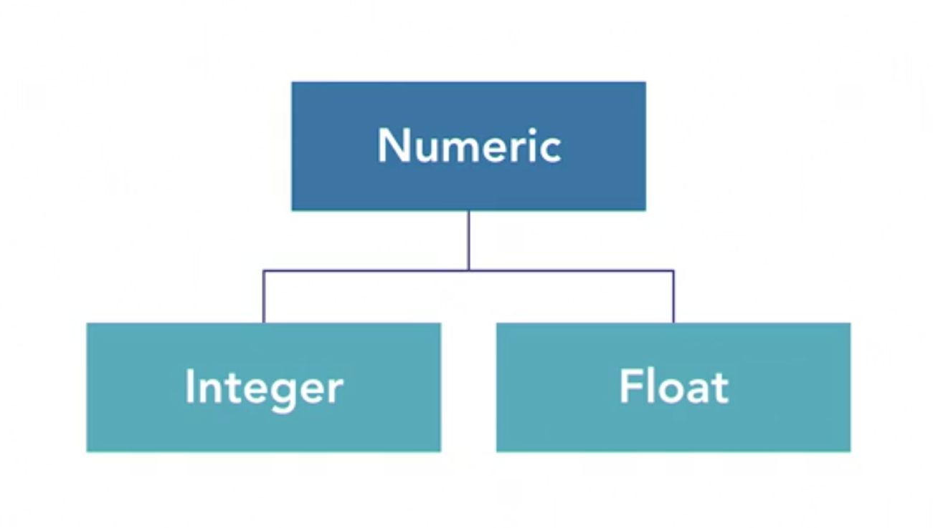

Slide 13
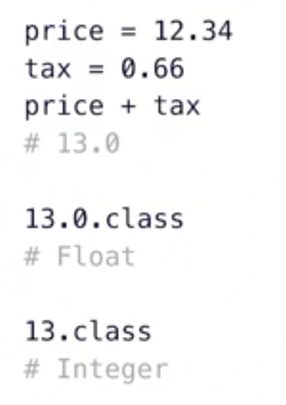
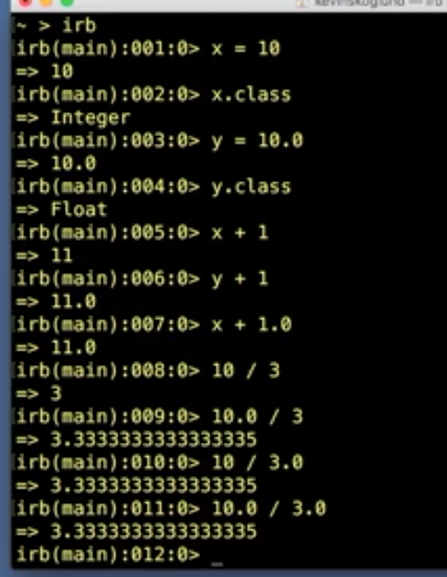
Floats

Slide 14
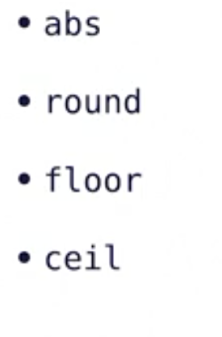
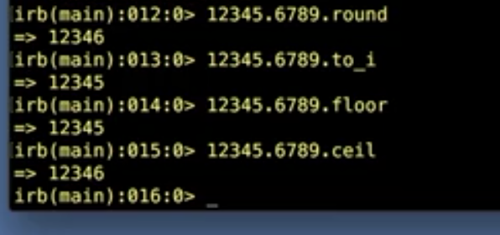
Floats methods

Slide 15
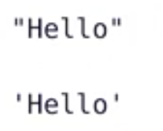
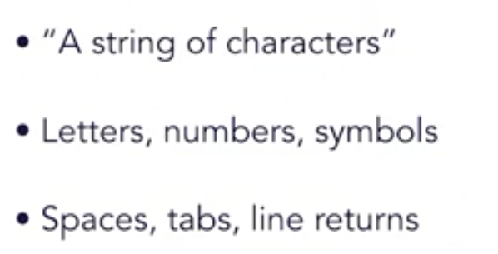
string
A sequence of characters

Slide 16
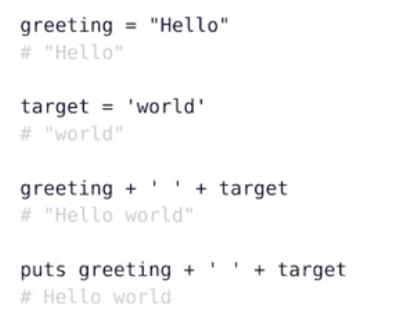
String:concatenations

Slide 17
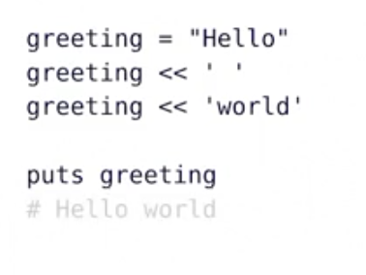
Strings Append

Slide 18
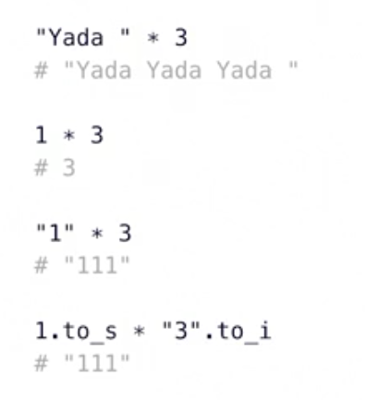
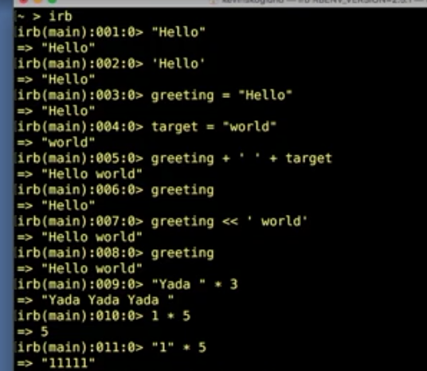
Strings:Multiplication

Slide 19
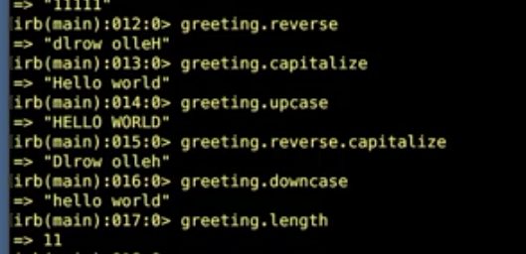
String Methods
Reverse
Capitalize
Upcase
Downcase
length

Slide 20
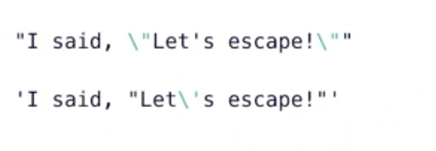
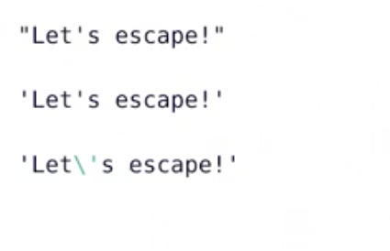
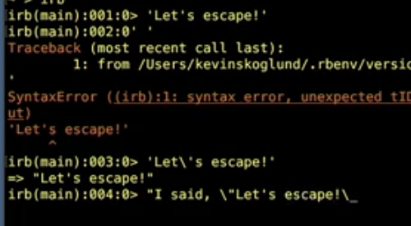
String Escaping

Slide 21
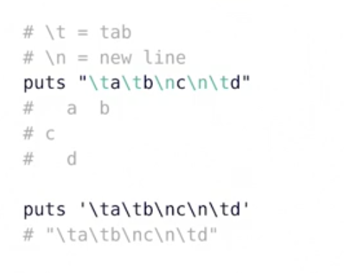
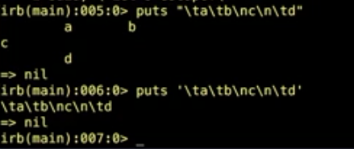
Strings:control Characters

Slide 22
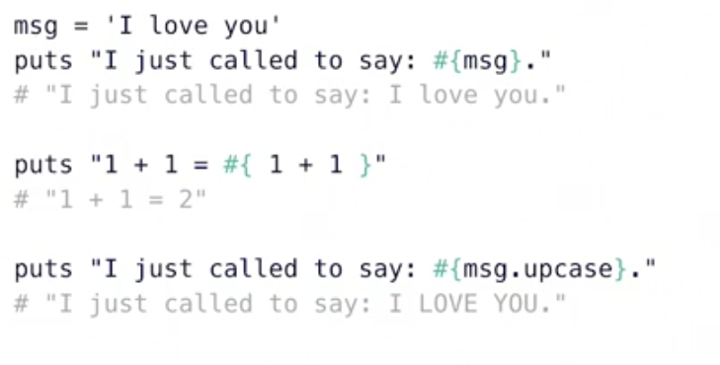
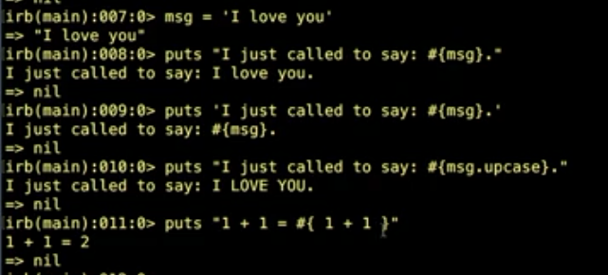
Strings:interpolations

Slide 23

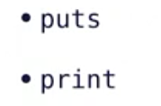
Outputs

Slide 24
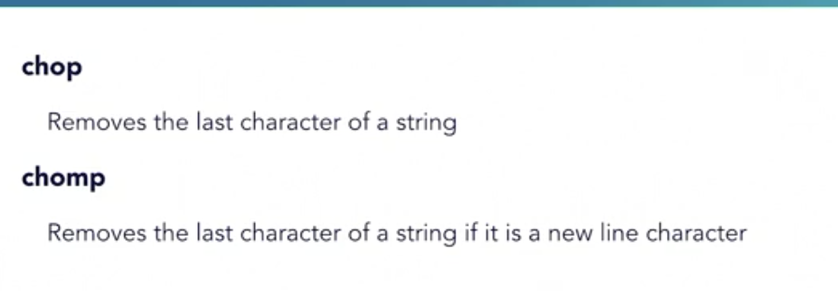
Input gets

Slide 25
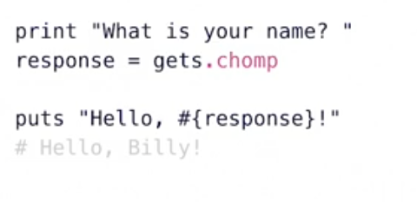
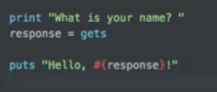

Slide 26
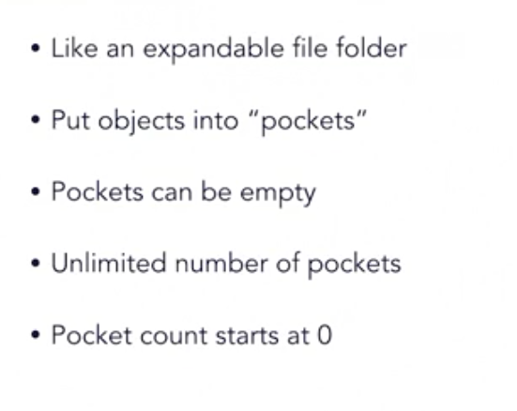
Arrays
An ordered, integer-indexed collection of Object

Slide 27
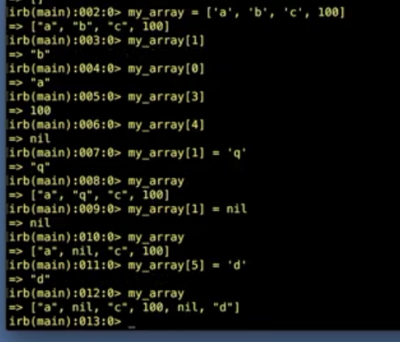
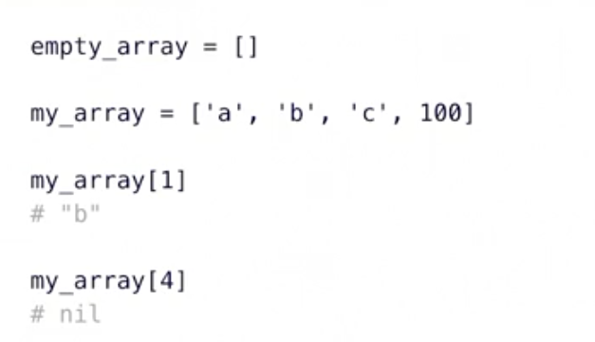
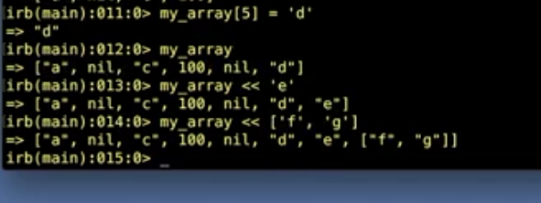

Slide 28
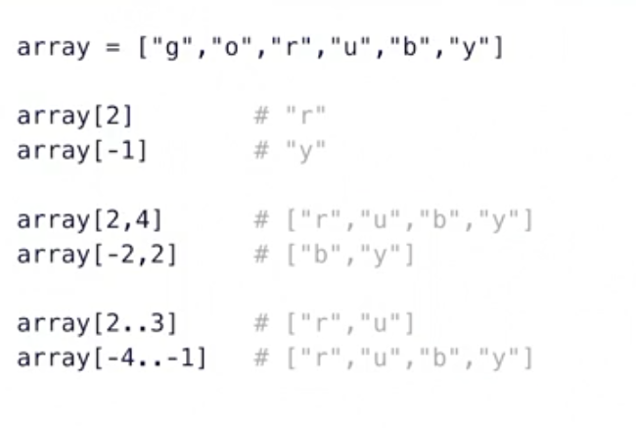
Array[]

Slide 29
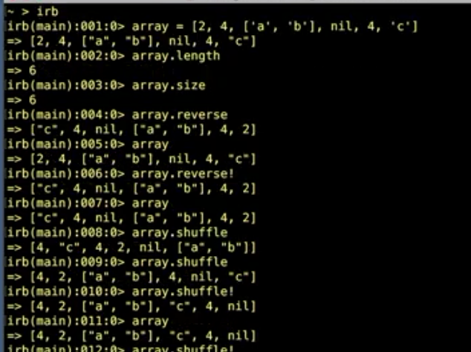
Array Methods
Length
Size
Reverse
Shuffle
Uniq
Compact
Flatten
Include
Delete_at
Delete(”c”)
Join(-)
Split(,)

Slide 30
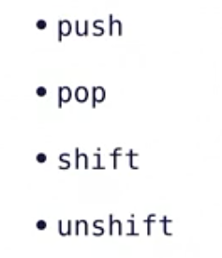

Slide 31
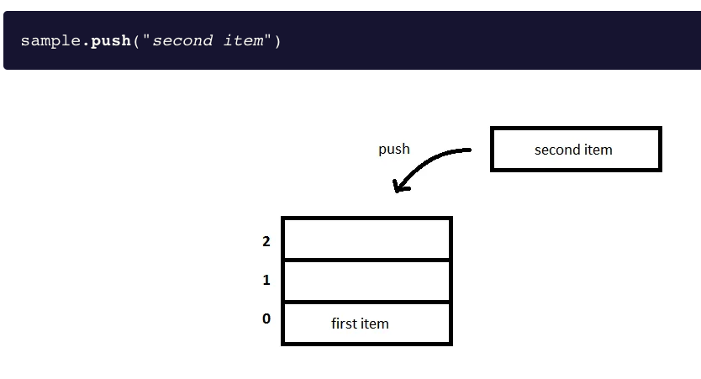
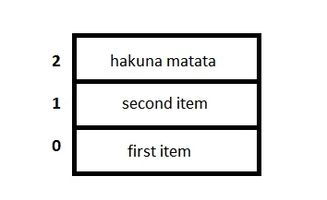
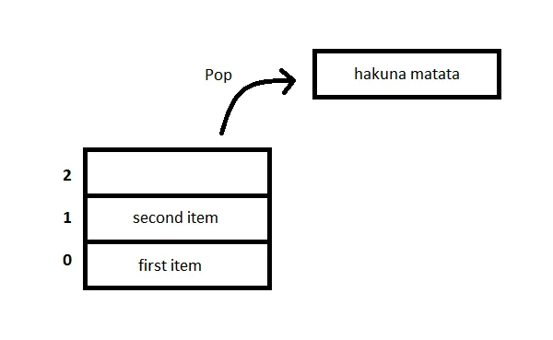

Slide 32
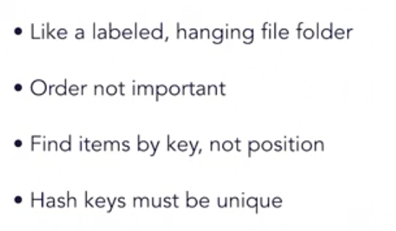
hash
An unordered, object-indexed collection of object(or key values pairs)

Slide 33
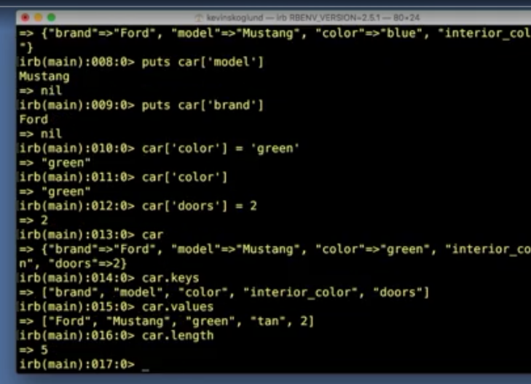


Hashes

Slide 34




symbol

Slide 35


Booleans
An object that is either true or false

Slide 36

Boolean methods
True.class
Includes?(2)
Nil?
Between?
Empety?
Hash. Hash_key?
Has_value

Slide 37


Ranges

Slide 38




Constant

Slide 39


Nil

Slide 40


challenge

Slide 41


Slide 42

Control Structures

Slide 43

Coditionals:if

Slide 44

Coditionals:else

Slide 45


Conditinal:elsif

Slide 46



Conditional: unless

Slide 47


Unless

Slide 48



Conditional : Case

Slide 49


Case with Comparison

Slide 50



Slide 51


Conditional Shorthand operator
Conditional Ternary Operator

Slide 52

Coditional: Or Operator

Slide 53

Loops

Slide 54

Loops: Control Methods

Slide 55

Loops: Example

Slide 56

Loops: while, until

Slide 57

Loops:Example

Slide 58





Slide 59



Slide 60


Slide 61
iterator
Iterate
To say or do again
To apply a procedure repeatedly
To perform code on each item in a set

Slide 62

Iterator:example

Slide 63

Iterator: times,upto, downto, each

Slide 64

Iterator: Block Variable

Slide 65

Iterator:By Classs

Slide 66

Iterators:for .. in

Slide 67



Slide 68



Slide 69

Challenge: Blanket Patterns

Slide 70


Slide 71

Tips

Slide 72



Solutions

Slide 73


Slide 74

Best Practices
Give Ruby files an .rb extension
Put shebang line at the top
#!/usr/bin/env ruby

Slide 75

Block Variable
|a|

Slide 76


Exit a Running Script
Automatically, after the las line of code

Slide 77
Challenge .- Guessing Game
Ask Player for their name
Say hello and explain rules
Pick a random number
Get player`s guess
Tell player if guess is correct
Loop to allow three guesses

Slide 78
Rand
#returns a float in 0.01 .. 1.00
Rand 100
Returns and intenger in 0..99
number=rand(10)
1.upto()
if

Slide 79


Slide 80

Solutions

Slide 81


Enumerables

Slide 82


Slide 83

Enumerable:Methods

Slide 84


Code Block

Slide 85

Code Block:Format

Slide 86


Code Blocks: Block Variable

Slide 87

Block Variable

Slide 88


Slide 89


Local vs Block Variable

Slide 90

Code Blocks: Common usage

Slide 91

Code block

Slide 92

Find Methods

Slide 93


Slide 94


Slide 95

Map Methods

Slide 96


Slide 97


Slide 98


Slide 99



Slide 100


Slide 101


Slide 102


Slide 103


Slide 104

Inject Methods

Slide 105



Slide 106


Slide 107


Slide 108



Slide 109


Slide 110


Slide 111


Slide 112


Slide 113


Comparison Operator

Slide 114


Comparison Operator

Slide 115

Sort Methods:sort

Slide 116


Slide 117

Sort Methods:sort_by

Slide 118

Sort Methods:without < = >

Slide 119

Sort methods

Slide 120

Sort methods

Slide 121

Sort methods :sorting hashes

Slide 122


Slide 123

Merge methods

Slide 124

Merge:without a block

Slide 125

Merge:with a block

Slide 126

Merge:with a block

Slide 127

Merge!

Slide 128


Slide 129

CHALLENGE RUBY _BLANKS

Slide 130

CHALLENGE RUBY _BLANKS

Slide 131


Slide 132


Slide 133

Define and call methods

Slide 134

Define and call methods

Slide 135

Methods name

Slide 136




Slide 137


Slide 138
Methods
Instructions to perfomos a specific task, package as a unit
Can be defined once and called multiples times
Don’t repeat yourself(DRY)

Slide 139

Methods

Slide 140




Slide 141

Variable Scope Indicator

Slide 142

Variable Scope

Slide 143


Slide 144

Arguments

Slide 145

Arguments

Slide 146

Arguments Parentheses

Slide 152

Online Documentations
https://www.ruby-lang.org/es/

Slide 153

Online documentación
https://ruby-doc.org/

Slide 154


Comand line Documentation

Slide 155
Ruby on Rails
Open sources web application framework
Written in Ruby
Created in 2003 by David Heinemeier Hansson(DHH)
Foundation of Basecamp
Released as open source in 2004

Slide 156
MVC Architecture
Model (the data object)
View(presentation layer)
Controller(user events)

Slide 157

Basic Web Architecture

Slide 158

MVC Web Archictecture

Slide 159
Launch a ruby on Rails Project
Create (or download) project
Create databases
Configure project to use databases
Run bundle install

Slide 160

Destiny is here

